Slide 1
BITS ZG553: Real Time Systems L11 – Programming Languages for Real Time Systems
K G Krishna
WILP Division, BITS-Pilani, Hyderabad

Slide 2

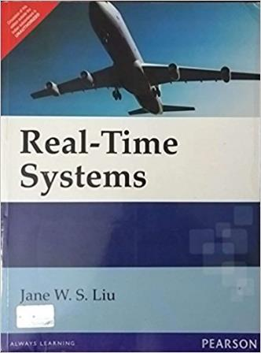
Text Book / References
Reference (R1)
Text Book (T1)
Note: As the above two books focus on theoretical treatment of the subject, Students are strongly advised to refer to web sources / MOOCs videos / library within their own organizations for more practical understanding of the topics.

Slide 3
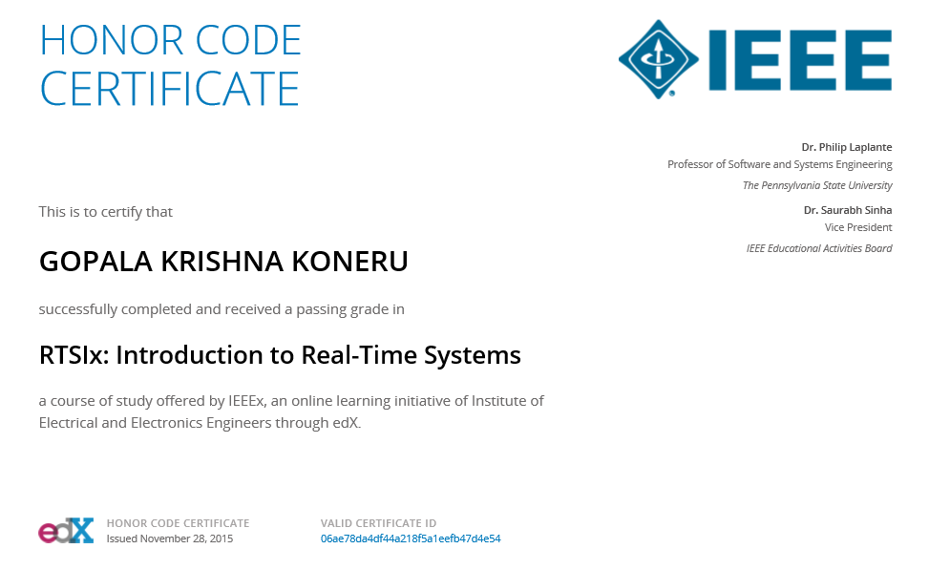
Excellent MOOCs Videos
(Coursera, edX,…)

Slide 4
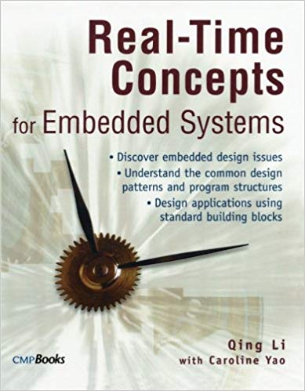
RTS Primer – For Light Reading

Slide 5
L-11: Programming Languages for Real Time Systems
[Ref: Notes/PPT]
Note: Students are requested to NOT to rely on PPTs/Recorded sessions as their only source of knowledge, explore sources within your own organization or web for any specific topic; attend classes regularly and involve in discussions;
PLEASE DO NOT PRINT PPTs, Save the Environment!
Source PPT Courtesy: Some of the contents of this PPT is sourced from Presentatoons of Prof K R Anupa / Prof B Mishra, BITS-Pilani WILP Division

Slide 6
Language Taxonomy
Two different ways to partition the world of programming languages:
Imperative, functional, logic, other
Procedural or declarative
Imperative languages:
Involve assignment of variables
Most widely used language are imperative, e.g. C, Java, Ada 95, Fortran, BASIC
Functional (applicative) languages employ repeated application of some function (e.g. LISP).
Logic programming involves a formal statement of the problem without any specification of how it is solved (e.g. PROLOG).
Procedural languages are defined by a series of operations (most languages you can think of).
“Procedural” also describes a style of programming that is not object-oriented.
Declarative (non-procedural) languages involve specification of rules defining the solution to a problem (PROLOG, Spreadsheets).
Object-oriented describes a style of programming. Languages written to support this are called object-oriented.

Slide 7
Which language to choose ?
At present do we need pay too much attention on how to select a programming language ?
For present day real-time systems, it is almost like to choose between the two: C & C++.
If you have large S/W projects where productivity of the programmers and maintainability is an issue, go for C++.
If response-time is the primary driving factor, go for C.
Now a days, majority of the applications of real-time systems are written in Java.
Web-based applications are in HTML5, Javascript, Jquery, Angular JS, Phonegap, PHP, ASP, …
So, followings can be generally suggested:
System Software: C
Middleware and Applications: C++
Applications: Java, HTML5 and other web development languages.

Slide 8
Fitness of a Programming Language for Real-Time Applications
Five criteria of Cardelli in selecting a programming language:
Economy of execution: How fast does a program run?
Economy of compilation: How long does it take to go from sources to executables?
Economy of small-scale development: How hard must an individual programmer work?
Economy of large-scale development: How hard must a team of programmers work?
Economy of language features: How hard is it to learn or use a programming language?

Slide 9
Assembly Languages
In terms of Cardelli’s criteria, assembly languages have
Excellent economy of execution
Excellent economy of compilation
Poor economies of small- and large-scale development of languages features
So Assembly languages are used
Where there is tight timing situations e.g. interrupt service routines, part of device drivers , sophisticated signal-processing algorithms etc.
In controlling hardware features that are not supported by compilers
Where predictable performance for the code is extremely difficult or impossible using high level language because of undesirable programming language-compiler interactions.
For writing entire software for custom-designed CPU with a small instruction set and without high-level language support.
For debugging hard problems below the high-level language code and tracing the stream of fetched instructions by logic analyzer.
For teaching and learning computer architectures

Slide 10
Procedural Languages
Example: Ada, C, Fortran, Visual Basic etc.
Features advantageous for Real Time Systems:
Modularity (design become simpler)
Strong typing (prevents data corruption through unwanted type conversion)
Abstract data typing (allow user to define custom types)
Versatile parameter passing mechanism
Dynamic memory allocation
Exception handling

Slide 11
Procedural Languages
Parameter passing mechanisms
Call by value: The value is passed to the function and it manipulates the value passed, not the source
Call by reference: Address of the parameter is passed, so any manipulation of the parameter inside the function is reflected in the original parameter.
Global variables:
Global variables are within the scope of all code, so faster than references to variables passed via parameter list, which require additional memory accesses.
But they are dangerous because references to them can be made by unauthorized code, potentially introducing faults that can be hard to isolate.
Recursions
A procedure can call itself.
It is elegant and sometimes can’t be avoidable.
Procedure call requires allocation on stack for passing parameters and for storage of local variables.
So precaution needs to be taken for the recursion to terminate early, otherwise if may lead to stack overflows.
Also allocation and deallocation of parameters may be a costly operation with respect to time.

Slide 12
Cardelli’s Matrix for Procedural Languages
Economy of execution
High, because strong type-checking improve code generation
Economy of compilation
High, because modules can be compiled independently
Economy of small-scale development
High, since type-checking can catch many errors, reducing testing and debugging efforts
Economy of large-scale development
High, because data abstraction and modularization allow independent team of programmers to develop modules in parallel (provided interfaces between modules are well defined)
Economy of language features
High, because learning is easier due to orthogonality of the language features

Slide 13
Object-Oriented Languages
Example: C++, C#, Java etc.
Features:
Data Abstraction (e.g. Class)
Inheritance (e.g. Derived Class)
Polymorphism (e.g. Operator Overloading)
Messaging

Slide 14
Cardelli’s Matrix for Object-Oriented Languages
Economy of execution
Low, because extra encapsulation (like class and method) causes the execution slower
Economy of compilation
Low, because it may require recompilation of base classes while compiling the inherited classes
Economy of small-scale development
High, since individual programmers can take help of class libraries and frameworks
Economy of large-scale development
Low, sometimes these languages have poor modularity properties. E.g. it is easy to override a method that should not be overridden, or to re-implement a class in a way that causes problems in subclasses.
High, since separate teams can develop separate modules, making the development highly parallel
Economy of language features
Low, because learning takes time due to many features

Slide 15
Object-Oriented vs Procedural Languages
Object oriented languages provide better design.
But for real time systems, the main disadvantages is that they lead to unpredictable and inefficient system.
So the decision should be made from case to case basis.
Usual norms followed is:
Procedural languages: For System Software (e.g. C)
Object-oriented languages: For Application and Middleware (e.g. C++, Java)

Slide 16
Code Optimization Techniques
Use of arithmetic identities
Addition by 0 or multiplication by 1 can be avoided
Reduction in Strength
Use of fastest machine-language instructions for a given expression.
For example
x * 2 can be replaced by x << 1
x / 4 can be replaced by x >> 2
Repeated calculations of the same sub-expression
Example:
x = 6 + a * b;
y = a * b + z;
Can be replaced by
t = a * b
x = 6 + t
y = t + z

Slide 17
Code Optimization Techniques
Use of intrinsic functions
Intrinsic functions are macros with inline code
Use of intrinsic function improves performance, because parameter passing to the functions is eliminated
Constant folding
If a program uses ∏ / 2, it can be pre-computed and stored as pi_div_2.
Loop invariant removal
Move the computations which can be moved out of the loop.
x = 100;
while (x > 0)
x = x -(y + z);
Can be replaced with
x = 100;
t = y + z;
while (x > 0)
x = x - t;

Slide 18
Code Optimization Techniques
Loop induction elimination
for(i = 1; i <= 10; i++)
a[i+1] = i+1;
Can be replaced with
for(j = 2; j <= 11; j++)
a[j] = j;
Here i and j are called loop induction.
Use of registers and caches
Dead-code removal

Slide 19
Code Optimization Techniques
Flow-of-control optimization
Unnecessary branch to branch instructions are replaced by single branch instructions.
goto label_1;
label_0: y = 1;
label_1: goto label_2;
Can be replaced by
goto label_2;
label_0: y = 1;
label_1: goto label_2;

Slide 20
Code Optimization Techniques
Constant propagation
x = 100;
y = x;
Can be replaced by
x = 100;
y = 100;
Dead store elimination
t = y + z;
x = func(t);
Can be replaced by
x = func(y + z);
Dead variable elimination
x = y + z;
x = z;
Can be replaced by
x = z;

Slide 21
Code Optimization Techniques
Short circuit Boolean code
if(a > 100){
if(b < 20) {
…
…
}
}
Is equivalent to
if((a > 100) &&(b < 20)) {
…
…
}
ANSI-C compiler will generate a better code for the second case because it evaluates expressions from left to right and drops out at first FALSE condition, whereas other compilers may generate a better code for the first case.

Slide 22
Code Optimization Techniques
Loop unrolling
for(i = 0; i < 4; i++)
a[i] = x[i] * y[i];
Can be replaced by
a[0] = x[0] * y[0];
a[1] = x[1] * y[1];
a[2] = x[2] * y[2];
a[3] = x[3] * y[3];
Such code is very much useful where vector operations are involved.

Slide 23
Code Optimization Techniques
Loop jamming (or Loop fusion)
for(i = 0; i < 100; i++)
x[i] = y[i] * 8;
for(i = 0; i < 100; i++)
a[i] = x[i] * y[i];
Can be replaced by
for(i = 0; i < 100; i++)
a[i] = x[i] * y[i] * 8;

Slide 24
Code Optimization Techniques
Cross-branch elimination
If same code appears in multiple cases in a switch-case statement, combine the cases.
Can be replaced by
switch(x)
{
case 0:
case 2:
x++;
break;
case 1:
x = x + 2;
break;
default:
break;
}
switch(x)
{
case 0:
x++;
break;
case 1:
x = x + 2;
break;
case 2:
x++;
break;
default:
break;
}

Slide 25
Additional Optimization Considerations
Arrange entries in the table so that most frequently sought values are the first to be compared
Replace threshold tests on monotone functions (continuously increasing or continuously decreasing) by tests of their parameters, thereby avoiding evaluation of the function itself
if(exp(x) < exp(y)) {
…
}
can be replaced by
if(x < y) {
…
}
for monotone functions
Keep the most frequently used procedures nearby in order to take the advantages of locality of reference in a cached or paged system.
Keep the frequently used data nearby in order to take the advantages of locality of reference in a cached or paged system.
Aligning memory access consumes lesser time in memory access operation.
Match data types to the architecture

Slide 26
Example
Can you optimize the following C function ?
int function(int *a, int *b, int count){
int c = 0;
int i = 0;
int temp1 = 0;
int temp2 = 0;
if(a == null)
return -1;
if(b == null)
return -1;
for(i = 0; i < count; i++) {
temp1 = a[i] / 2;
temp2 = b[i] / 4;
c += temp1 * temp2;
}
return c;
}

Slide 27
Example (contd.)
One way could be the following.
int function(int *a, int *b, int count){
int c = 0;
int i = 0;
if((a == null) || (b == null))
return -1;
for(i = 0; i < count; i++) {
c += (a[i] * b[i]) >> 3; /* Divide by 8 */
}
return c;
}

Slide 28
Thank You.
Any Questions?

